Slide 1
FARWESTERN UNIVERSITY Digital Logic
Digital clock simulation

Slide 2
TEAM MEMBERS
Bhawana Chaudhary
Dipesh Joshi
Nisha Saud
Rahul Bhatt
Sarita Chand

Slide 3
TEAM MEMBERS
Bhawana Chaudhary
Dipesh Joshi
Nisha Saud
Rahul Bhatt
Sarita Chand

Slide 4

Contents
Introduction
Objective
Components Used
Implementation
Conclusion

Slide 5
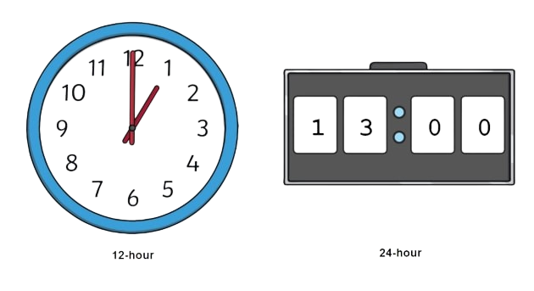
Introduction
A Digital clock is alternative to traditional analog clock .A digital clock is a type of clock that displays the time digitally. In this design, simulation of digital clock is capable of displaying seconds, minutes and 24 hours timing is presented. This simulation consists of 6 digits 2 digit for seconds, two digit for minutes and remaining two digit for hours.

Slide 6
Objectives
To build Digital Clock.
To increase and build up knowledge.
To know about the working of each and every component and their role in the circuit.
To apply our knowledge and understanding into practice.

Slide 7
Components Used
555 Timer IC
Voltage Source
Resistor
Capacitor
Seven segment display decade counter
Triple 3-input positive AND gate
Seven segment common cathode

Slide 8
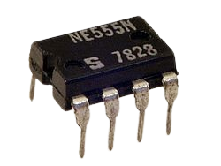

555 Timer IC
The 555 timer IC is an integrated circuit used in a variety of timer, delay, pulse generation, and oscillator applications.

Slide 9

Voltage Source
A voltage source is a two-terminal device that creates a potential difference between two points in a circuit, allowing an electric current to pass through.

Slide 10


Resistor and Capacitor
Resistor is a passive electrical component with two terminals that are used for either limiting or regulating the flow of electric current in electrical circuits.
Capacitor is a two-terminal electrical device that can store energy in the form of an electric charge.

Slide 11

Seven segment display decade counter
7-segment Displays can be used together to display digits from 0 to 9 as well as a few characters for use in acounting circuit or interfaced to a microcontroller.

Slide 12


Triple 3-input positive AND gate
This device contains three independent gates each of which performs the logic AND function.

Slide 13
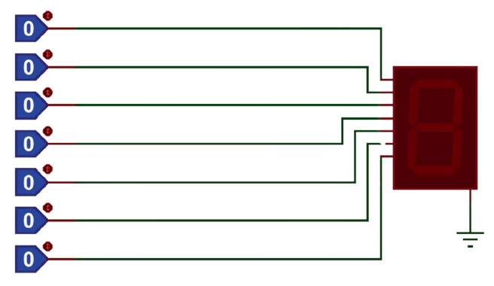
Seven segment common cathode
Seven segment common cathode is an array of 7 LEDs, the LED cathodes are all tied together and are common. This is typical LED display with each LED segment labeled with an alphabetical character.

Slide 14
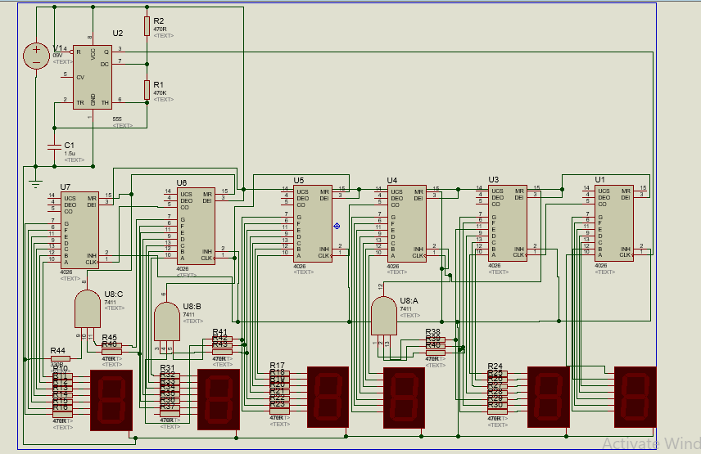
Implementation (using Proteus)

Slide 15
Conclusion
Here, we successfully built Digital clock simulation.
Increased our knowlege and understanding.
Done good practice of our knowledge.

Slide 16
THANK YOU
ANY QUERIES ?

